Slide 1

Predicting the Likelihood of H1N1 Vaccination
Using Data Mining Methods:
Analyzing Behavioral and Demographic Data
ADS502 Final Project Team 6
Luke Awino- Team Member
Kevin Stewart - Team Member
Roberto Cancel - Team Representative
Notes:
Hi - Welcome the Team 6 presentation for ADS502. Predicting the likelihood of H1N1 Vaccination Using Data Mining Methods. In this study we’ll be analyzing behavioral and demographic data

Slide 2
The problem
Vaccination Efforts
Behavior & Demographics
Objective
Vaccination efforts, specifically for H1N1 and COVID19 have been hampered by public health communication (and miscommunication), public mistrust, and behavioral / demographic differences.
Contraction Avoidance
Opinion of H1N1, risks, and vaccination safety
Demographics: Race, Age, education, employment status, marital status
To deploy data mining methods to determine our ability to predict the likelihood of a patient adopting the H1N1 vaccine using behavioral and socio-demographic data.
Notes:
Kevin

Slide 3
EDA Process
Import & Merge
Clean & Wrangle
Transform & Prepare
DataDriven.com's Flu Shot Learning
Merged feature and target datasets
Removed Seasonal Flu data
Clean & Wrangle
Determined extent of missing Data
Attempted Imputation by mode
Complete Case Review for less bias
Model Preparation
Re-expressed categorical variables as numeric
Scaled
Partitioned 75/25
VIF
Notes:
Kevin

Slide 4
Models
There was three models used:
Logistic regression
Naive Bayesian
Random Forest
Models Used to test performance:
Chose Sensitivity as our measure of success since True Positives are the key to success.
Notes:
Roberto - we chose 3 different data mining methods including Logistic Regression, Naive Bayesian, and RandomForest to determine the best model to predict the likelihood of vaccination. We determined that sensitivity would be our measure of success since True Positives (or accurately identifying those that would be vaccinated) is the objective.

Slide 5
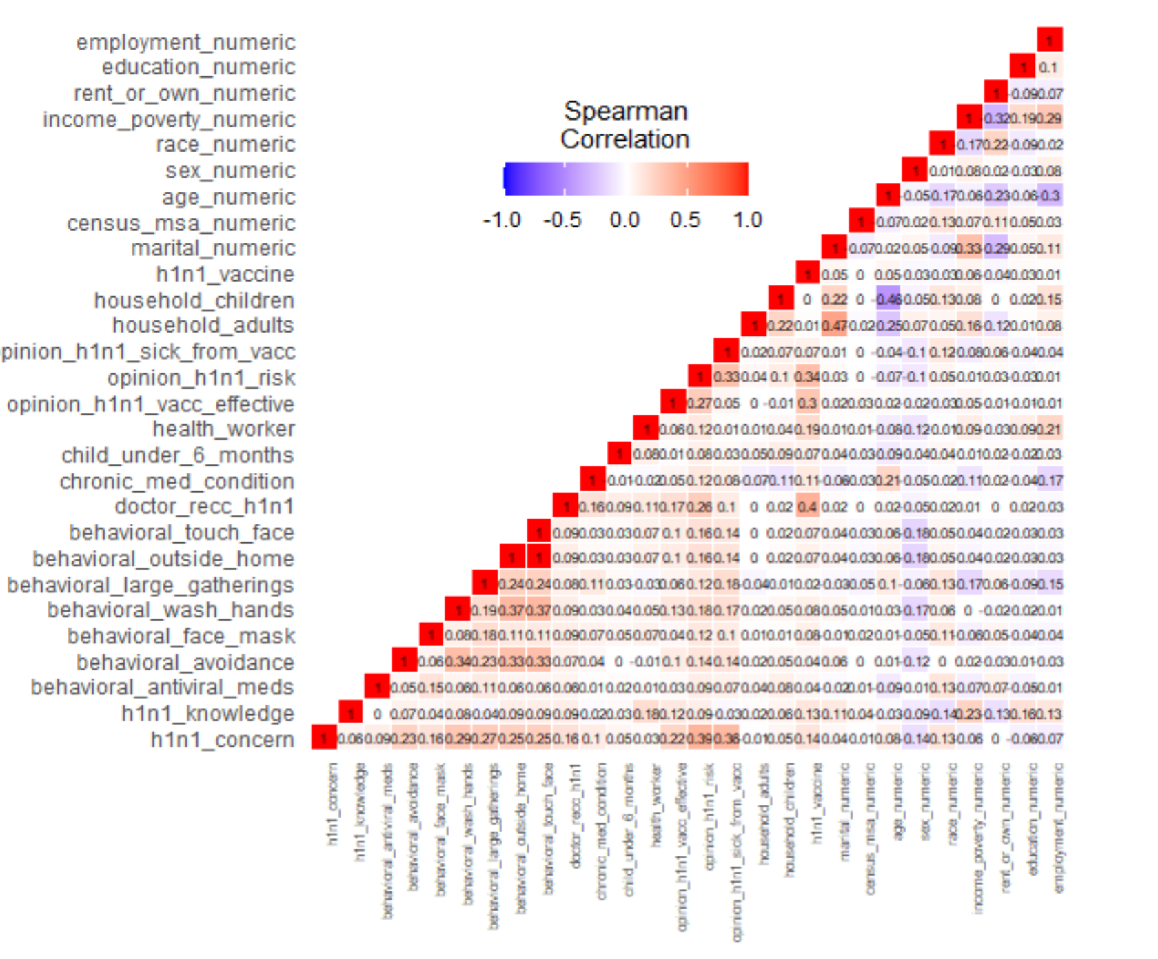
Logistic Regression
Predicting Binary Target variable
Removed multicollinearity thanks to VIF rationalization
Sensitivity:
LogReg_01 = 62.71%
LogReg_02 = 62.17%
Suggests the rationalized features were appropriately rationalized
Further feature reduction possible
Two Iterations:
Complete Feature Review
Rationalized Features by p-values
Notes:
The first model we chose was the Logistic Regression since our target variable was binary. Thanks to the Cleaning and Wrangling completed and described earlier, all missing values were removed and we tested for multicollinearity using Spearman’s Correlation since our predictors were binary and ordinal variables and the Spearman Correlation measures association between features rather than distance.

Slide 6
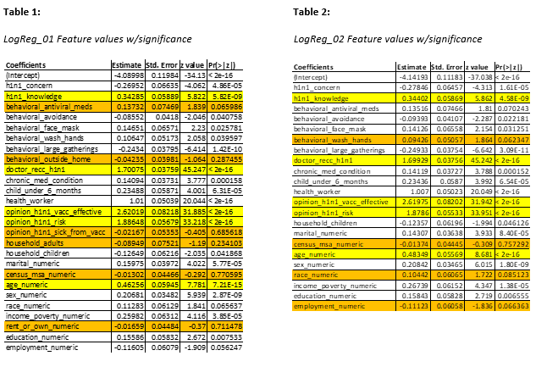
Notes:
Here we see the features, coefficients, and statistical significance of the features for each Logistic Regression iteration.
The Yellow highlighted features represent the top 5 features that influence the likelihood of vaccination., we notice they are consistent in both iterations.

Slide 7
Naive Bayes
Built Two Models
Model 1 baseline
Model 2 built with laplace smoothing and use kernels method
Model 1 Sensitivity equals 70.90% ,
Model 2 Sensitivity equal 69.32%
Naive Bayesian algorithms are able to handle missing values, so run the algorithm with them
Does not Require much training data
Is fast and has the ability to make prediction in real-time
Notes:
Kevin

Slide 8
Random Forest
-Number of trees-=100
-mtry = 5
-Random Forest oob = 6.53%
Notes:
Luke
Hello My Name is luke Awino I will be introducing the Random Forest model
-The model has 100 trees.
- Mtry indicates that the model ran 5 variables each time
-Random Forests generates an out of bag error rate,
-These predictions are based on how many times a prediction was misclassified
-Random Forest Out of bag Error Rate was 6.53%

Slide 9
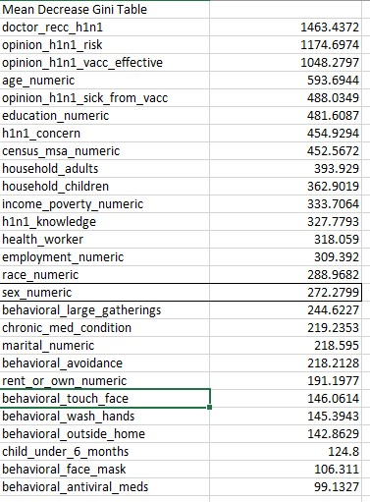
-27 Variables
-Used the top 60% variables
-Higher Mean indicates Higher variable importance
--Mean Gini Model = 8.59%
Notes:
Luke
-Single decision trees are easily interpretable
-Random Forests lose this feature , They use Variable importance measures to show important features
-We used the Mean decrease in Gini measure to pick variables
- The mean decrease gini measures the average of a total decrease in node impurity.
-A higher Mean gini indicates Higher Variable importance
--Interesting observations this variables were weighted more heavily in predicting if a person would get h1n1 vaccine
Doctor recommended
In their opinion they were at risk
In their opinion the vaccine was effective
And also age was an important factor in predicting

Slide 10
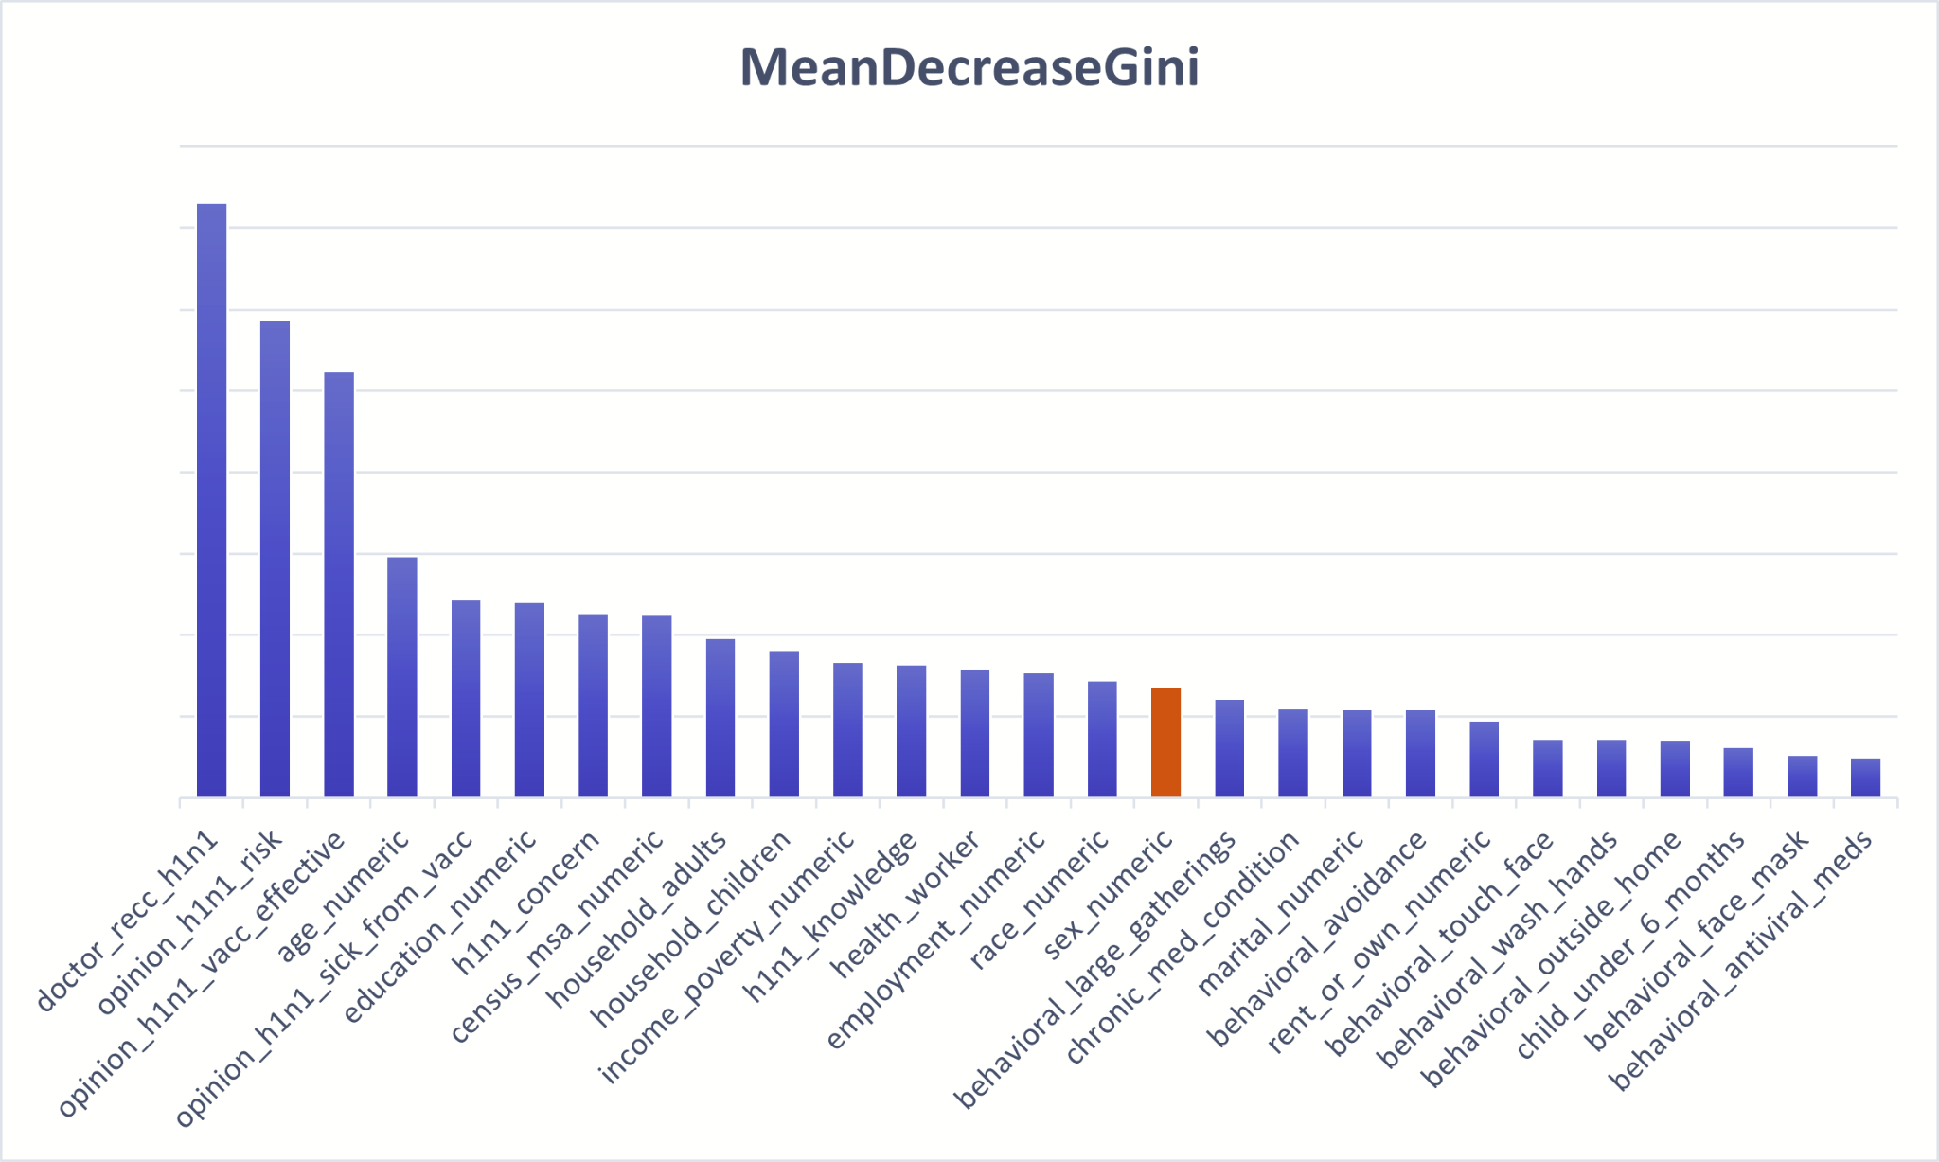
60%
Notes:
Luke
-The Top 60% of the variables were used
-everything to the left of sex variable
-In Using the variables from Mean Decrease Gini the out of bag error was 8.59%.
-Even though we used 60% of the variables the mean gini model had better specificity than the base model
-(58.28% vs 56.02%) specificity is the ability to classify a record positively.indicating having more variables isnt always better

Slide 11
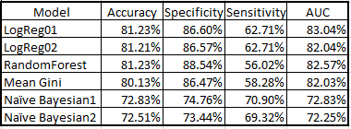
Recommendation
This study concluded that the Naïve Bayes method was the most precise model to predict the likelihood of vaccination using behavioral and demographic data.
Further evaluation for use in public health communication efforts are needed as we continue living in this ever-evolving world with frequent viral plagues.
Notes:
Luke
In Conclusion
This study concluded that the Naïve Bayes method was the most precise model to predict the likelihood of vaccination using behavioral and demographic data. Based on the Sensitivity or the being able to measure how often a test correctly generates a positive result which in this case is individuals likely to get the h1n1 vaccine
Further evaluation for use in public health communication efforts are needed as we continue living in this ever-evolving world with frequent viral plagues.
Thank You

